Slide 1



Chapter
5
Normal Probability Distributions
© 2012 Pearson Education, Inc.
All rights reserved.
<number> of 105

Slide 2
Chapter Outline
5.4 Sampling Distributions and the Central Limit
Theorem
© 2012 Pearson Education, Inc. All rights reserved.
<number> of 105

Slide 3
Section 5.4
Sampling Distributions and the Central Limit Theorem
© 2012 Pearson Education, Inc. All rights reserved.
<number> of 105

Slide 4
Section 5.4 Objectives
Find sampling distributions and verify their properties
Interpret the Central Limit Theorem
Apply the Central Limit Theorem to find the probability of a sample mean
© 2012 Pearson Education, Inc. All rights reserved.
<number> of 105

Slide 5
Sampling Distributions
Sampling distribution
The probability distribution of a sample statistic.
Formed when samples of size n are repeatedly taken from a population.
e.g. Sampling distribution of sample means
© 2012 Pearson Education, Inc. All rights reserved.
<number> of 105

Slide 6
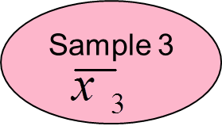
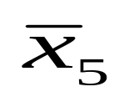
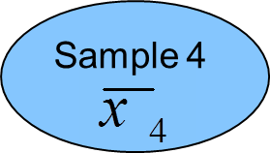
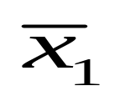
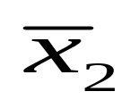
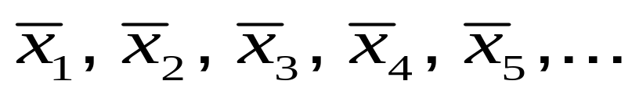
Sampling Distribution of Sample Means
Population with μ, σ
Sample 5
Sample 1
Sample 2
The sampling distribution consists of the values of the sample means,
© 2012 Pearson Education, Inc. All rights reserved.
<number> of 105

Slide 7

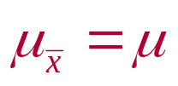

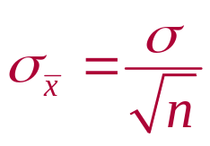
Properties of Sampling Distributions of Sample Means
The mean of the sample means, , is equal to the population mean μ.
The standard deviation of the sample means, , is equal to the population standard deviation, σ, divided by the square root of the sample size, n.
Called the standard error of the mean.
© 2012 Pearson Education, Inc. All rights reserved.
<number> of 105

Slide 8
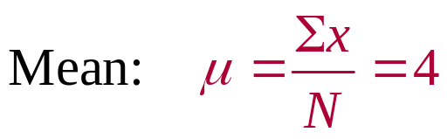
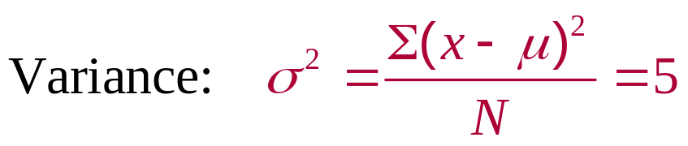
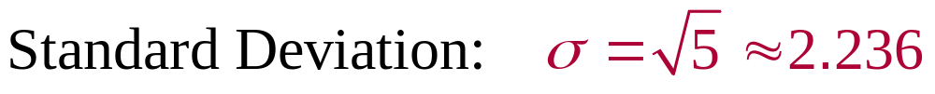
Example: Sampling Distribution of Sample Means
The population values {1, 3, 5, 7} are written on slips of paper and put in a box. Two slips of paper are randomly selected, with replacement.
  Find the mean, variance, and standard deviation of the population.
Solution:
© 2012 Pearson Education, Inc. All rights reserved.
<number> of 105

Slide 9
Example: Sampling Distribution of Sample Means
  Graph the probability histogram for the population values.
Solution:
P(x)
Probability Histogram of Population of x
0.25
All values have the same probability of being selected (uniform distribution)
Probability
x
1
3
5
7
Population values
© 2012 Pearson Education, Inc. All rights reserved.
<number> of 105

Slide 10
Example: Sampling Distribution of Sample Means
  List all the possible samples of size n = 2 and calculate the mean of each sample.
Solution:
Sample
Sample
1, 1
1
5, 1
3
1, 3
2
5, 3
4
These means form the sampling distribution of sample means.
1, 5
3
5, 5
5
1, 7
4
5, 7
6
3, 1
2
7, 1
4
3, 3
3
7, 3
5
3, 5
4
7, 5
6
3, 7
5
7, 7
7
© 2012 Pearson Education, Inc. All rights reserved.
<number> of 105

Slide 11
Example: Sampling Distribution of Sample Means
  Construct the probability distribution of the sample means.
Solution:
 | f | Probability
1 | 1 | 0.0625
2 | 2 | 0.1250
3 | 3 | 0.1875
4 | 4 | 0.2500
5 | 3 | 0.1875
6 | 2 | 0.1250
7 | 1 | 0.0625
f
Probability
© 2012 Pearson Education, Inc. All rights reserved.
<number> of 105

Slide 12
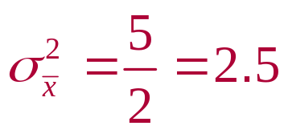
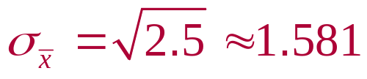
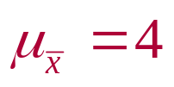
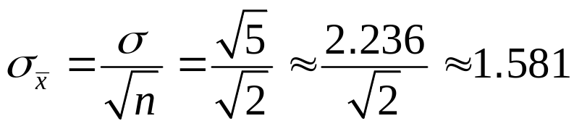
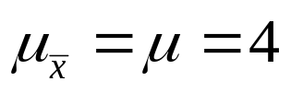
Example: Sampling Distribution of Sample Means
  Find the mean, variance, and standard deviation of the sampling distribution of the sample means.
Solution:
The mean, variance, and standard deviation of the 16 sample means are:
These results satisfy the properties of sampling distributions of sample means.
© 2012 Pearson Education, Inc. All rights reserved.
<number> of 105

Slide 13

Example: Sampling Distribution of Sample Means
  Graph the probability histogram for the sampling distribution of the sample means.
Solution:
P(x)
Probability Histogram of Sampling Distribution of
0.25
The shape of the graph is symmetric and bell shaped. It approximates a normal distribution.
0.20
Probability
0.15
0.10
0.05
2
3
4
5
6
7
Sample mean
© 2012 Pearson Education, Inc. All rights reserved.
<number> of 105

Slide 14


The Central Limit Theorem
If samples of size n ≥ 30 are drawn from any population with mean = µ and standard deviation = σ,
x
then the sampling distribution of sample means approximates a normal distribution. The greater the sample size, the better the approximation.
x
© 2012 Pearson Education, Inc. All rights reserved.
<number> of 105

Slide 15
The Central Limit Theorem
If the population itself is normally distributed,
x
then the sampling distribution of sample means is normally distribution for any sample size n.
x
© 2012 Pearson Education, Inc. All rights reserved.
<number> of 105

Slide 16
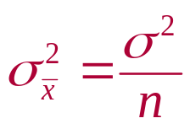
The Central Limit Theorem
In either case, the sampling distribution of sample means has a mean equal to the population mean.
The sampling distribution of sample means has a variance equal to 1/n times the variance of the population and a standard deviation equal to the population standard deviation divided by the square root of n.
Mean
Variance
Standard deviation (standard error of the mean)
© 2012 Pearson Education, Inc. All rights reserved.
<number> of 105

Slide 17
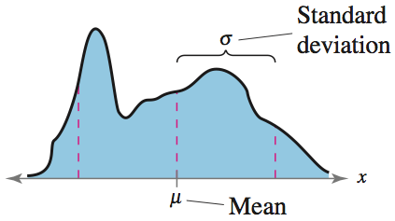
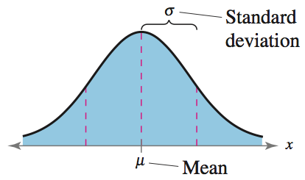
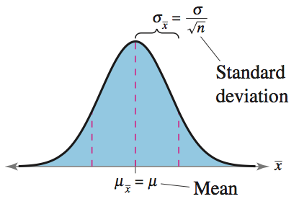
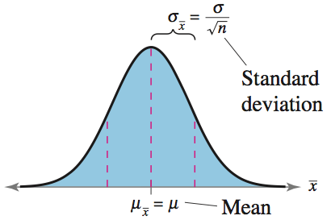
The Central Limit Theorem
Any Population Distribution
Normal Population Distribution
Distribution of Sample Means, n ≥ 30
Distribution of Sample Means, (any n)
© 2012 Pearson Education, Inc. All rights reserved.
<number> of 105

Slide 18
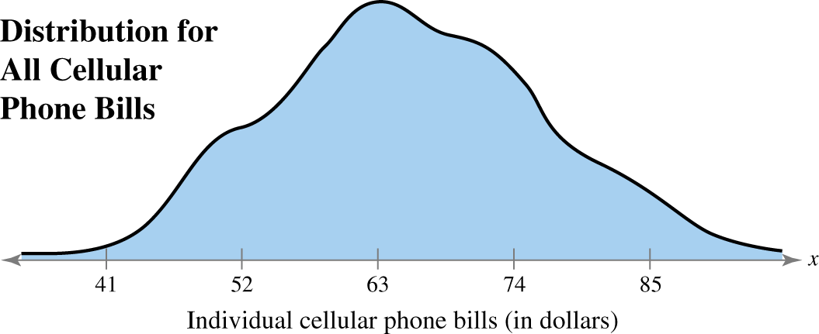
Example: Interpreting the Central Limit Theorem
Cellular phone bills for residents of a city have a mean of $63 and a standard deviation of $11. Random samples of 100 cellular phone bills are drawn from this population and the mean of each sample is determined. Find the mean and standard error of the mean of the sampling distribution. Then sketch a graph of the sampling distribution of sample means.
© 2012 Pearson Education, Inc. All rights reserved.
<number> of 105

Slide 19
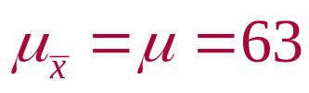
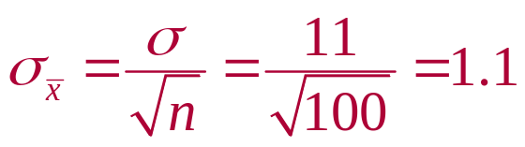
Solution: Interpreting the Central Limit Theorem
The mean of the sampling distribution is equal to the population mean
The standard error of the mean is equal to the population standard deviation divided by the square root of n.
© 2012 Pearson Education, Inc. All rights reserved.
<number> of 105

Slide 20
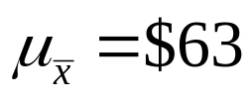
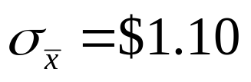
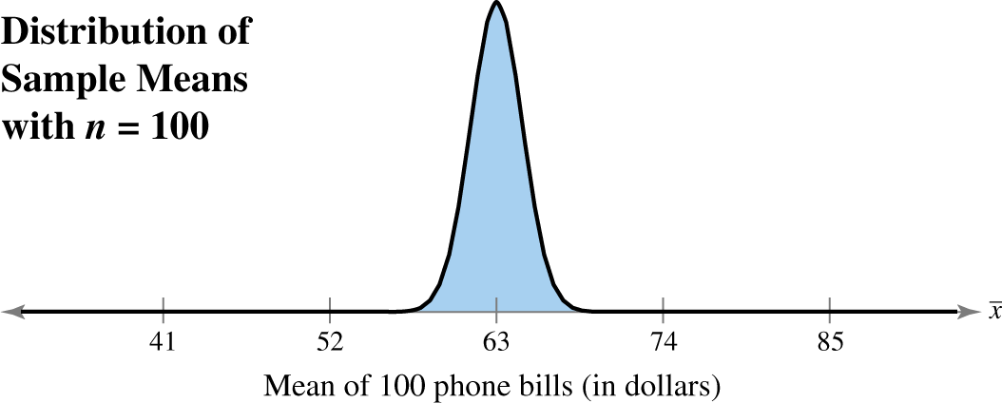
Solution: Interpreting the Central Limit Theorem
Since the sample size is greater than 30, the sampling distribution can be approximated by a normal distribution with
© 2012 Pearson Education, Inc. All rights reserved.
<number> of 105

Slide 21
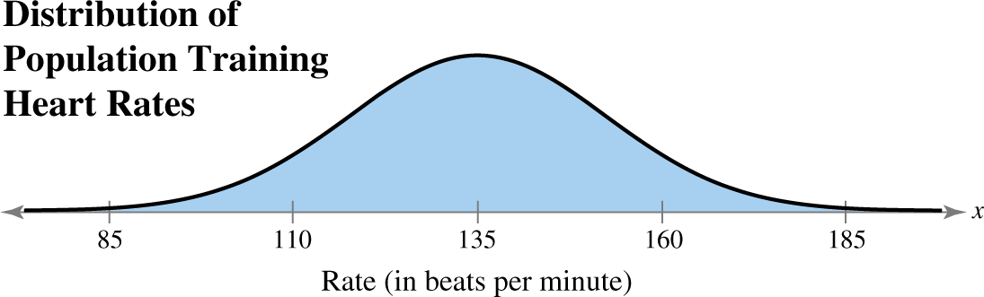
Example: Interpreting the Central Limit Theorem
Suppose the training heart rates of all 20-year-old athletes are normally distributed, with a mean of 135 beats per minute and standard deviation of 18 beats per minute. Random samples of size 4 are drawn from this population, and the mean of each sample is determined. Find the mean and standard error of the mean of the sampling distribution. Then sketch a graph of the sampling distribution of sample means.
© 2012 Pearson Education, Inc. All rights reserved.
<number> of 105

Slide 22
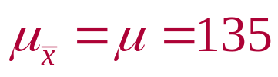
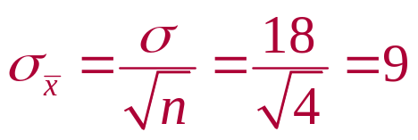
Solution: Interpreting the Central Limit Theorem
The mean of the sampling distribution is equal to the population mean
The standard error of the mean is equal to the population standard deviation divided by the square root of n.
© 2012 Pearson Education, Inc. All rights reserved.
<number> of 105

Slide 23
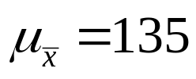
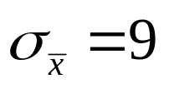
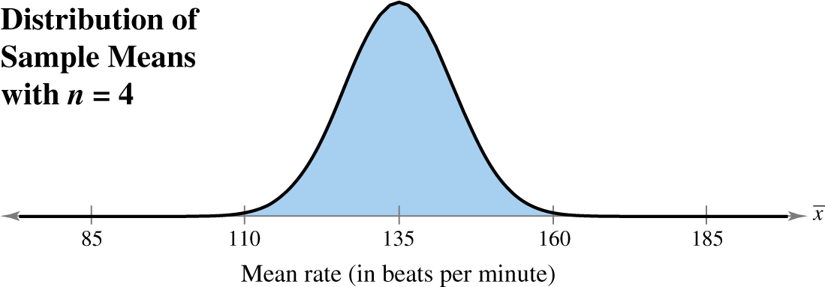
Solution: Interpreting the Central Limit Theorem
Since the population is normally distributed, the sampling distribution of the sample means is also normally distributed.
© 2012 Pearson Education, Inc. All rights reserved.
<number> of 105

Slide 24
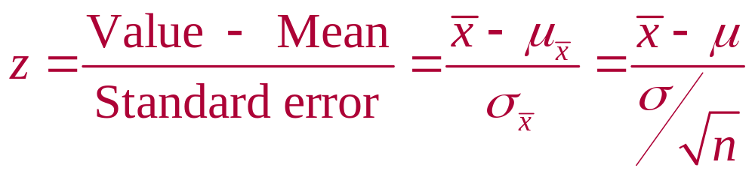
Probability and the Central Limit Theorem
To transform x to a z-score
© 2012 Pearson Education, Inc. All rights reserved.
<number> of 105

Slide 25
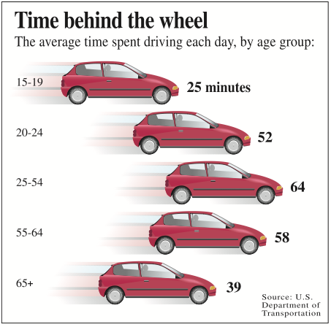
Example: Probabilities for Sampling Distributions
The graph shows the length of time people spend driving each day. You randomly select 50 drivers ages 15 to 19. What is the probability that the mean time they spend driving each day is between 24.7 and 25.5 minutes? Assume that σ = 1.5 minutes.
© 2012 Pearson Education, Inc. All rights reserved.
<number> of 105

Slide 26
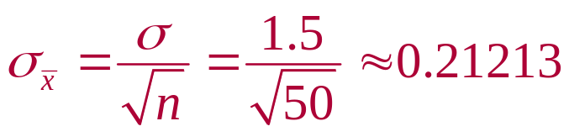
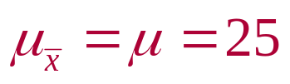
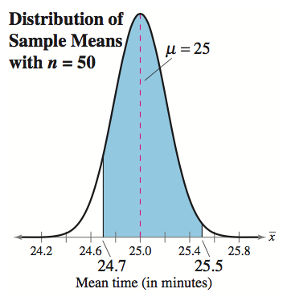
Solution: Probabilities for Sampling Distributions
From the Central Limit Theorem (sample size is greater than 30), the sampling distribution of sample means is approximately normal with
© 2012 Pearson Education, Inc. All rights reserved.
<number> of 105

Slide 27
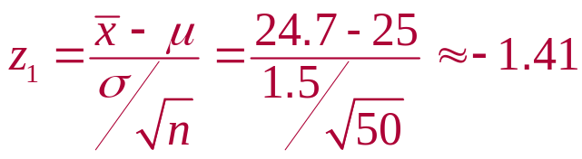
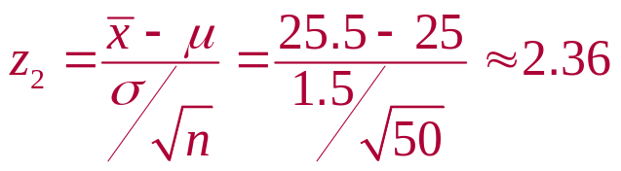
Solution: Probabilities for Sampling Distributions
Normal Distribution
μ = 25 σ = 0.21213
Standard Normal Distribution
μ = 0 σ = 1
P(24.7 < x < 25.5)
P(–1.41 < z < 2.36)
0.9909
0.0793
x
z
24.7
25
25.5
–1.41
0
2.36
P(24 < x < 54) = P(–1.41 < z < 2.36)
= 0.9909 – 0.0793 = 0.9116
© 2012 Pearson Education, Inc. All rights reserved.
<number> of 105

Slide 28

Example: Probabilities for x and x
An education finance corporation claims that the average credit card debts carried by undergraduates are normally distributed, with a mean of $3173 and a standard deviation of $1120. (Adapted from Sallie Mae)
What is the probability that a randomly selected undergraduate, who is a credit card holder, has a credit card balance less than $2700?
Solution:
You are asked to find the probability associated with a certain value of the random variable x.
© 2012 Pearson Education, Inc. All rights reserved.
<number> of 105

Slide 29
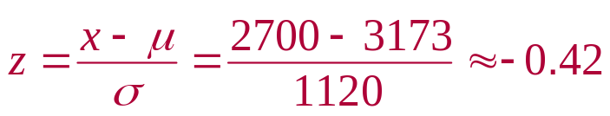
Solution: Probabilities for x and x
Normal Distribution
μ = 3173 σ = 1120
Standard Normal Distribution
μ = 0 σ = 1
P(x < 2700)
P(z < –0.42)
0.3372
x
z
2700
3173
–0.42
0
P( x < 2700) = P(z < –0.42) = 0.3372
© 2012 Pearson Education, Inc. All rights reserved.
<number> of 105

Slide 30

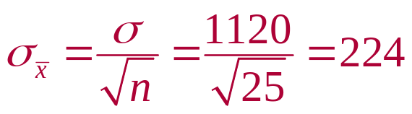
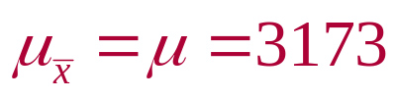
Example: Probabilities for x and x
You randomly select 25 undergraduates who are credit card holders. What is the probability that their mean credit card balance is less than $2700?
Solution:
You are asked to find the probability associated with a sample mean .
© 2012 Pearson Education, Inc. All rights reserved.
<number> of 105

Slide 31
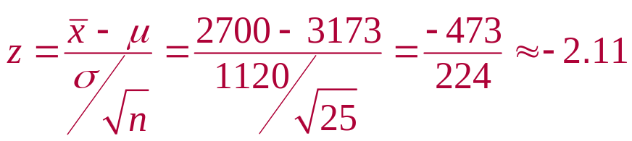
Solution: Probabilities for x and x
Normal Distribution
μ = 3173 σ = 1120
Standard Normal Distribution
μ = 0 σ = 1
P(z < –2.11)
P(x < 2700)
0.0174
x
z
2700
3173
–2.11
0
P( x < 2700) = P(z < –2.11) = 0.0174
© 2012 Pearson Education, Inc. All rights reserved.
<number> of 105

Slide 32
Solution: Probabilities for x and x
There is about a 34% chance that an undergraduate will have a balance less than $2700.
There is only about a 2% chance that the mean of a sample of 25 will have a balance less than $2700 (unusual event).
It is possible that the sample is unusual or it is possible that the corporation’s claim that the mean is $3173 is incorrect.
© 2012 Pearson Education, Inc. All rights reserved.
<number> of 105

Slide 33
Section 5.4 Summary
Found sampling distributions and verified their properties
Interpreted the Central Limit Theorem
Applied the Central Limit Theorem to find the probability of a sample mean
© 2012 Pearson Education, Inc. All rights reserved.
<number> of 105

